Slide 1
CORE JAVA DAY13
NEEHARIKA

Slide 2
Java JDBC
JDBC stands for Java Database Connectivity. JDBC is a Java API to connect and execute the query with the database. It is a part of JavaSE (Java Standard Edition). JDBC API uses JDBC drivers to connect with the database. There are four types of JDBC drivers:
JDBC-ODBC Bridge Driver,
Native Driver,
Network Protocol Driver, and
Thin Driver

Slide 3
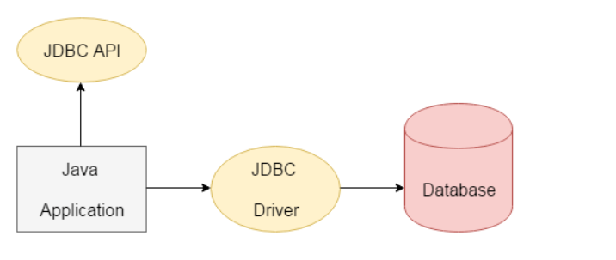

Slide 4
Why Should We Use JDBC
Connect to the database
Execute queries and update statements to the database
Retrieve the result received from the database.

Slide 5
What is API
API (Application programming interface) is a document that contains a description of all the features of a product or software. It represents classes and interfaces that software programs can follow to communicate with each other. An API can be created for applications, libraries, operating systems, etc.

Slide 6
JDBC Driver
JDBC Driver is a software component that enables java application to interact with the database. There are 4 types of JDBC drivers:
JDBC-ODBC bridge driver
Native-API driver (partially java driver)
Network Protocol driver (fully java driver)
Thin driver (fully java driver)

Slide 7
JDBC-ODBC bridge driver

Slide 8
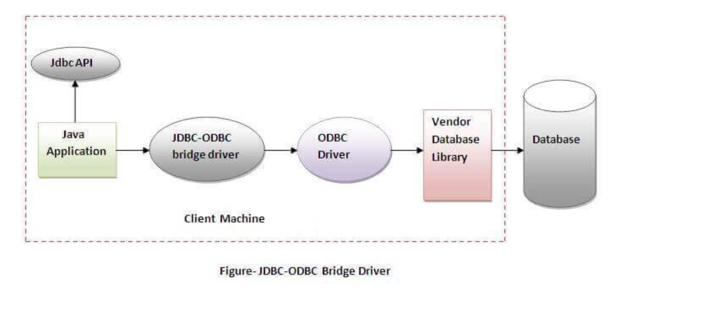

Slide 9
Advantages:
easy to use.
can be easily connected to any database.
Disadvantages:
Performance degraded because JDBC method call is converted into the ODBC function calls.
The ODBC driver needs to be installed on the client machine.

Slide 10
Native-API driver

Slide 11
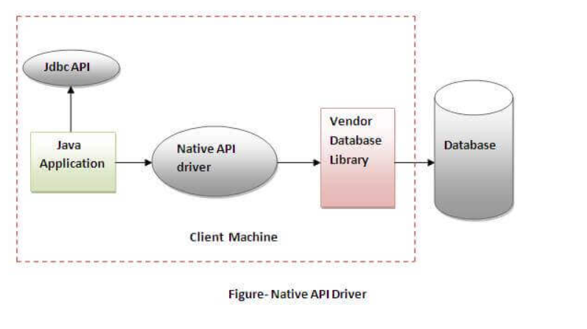

Slide 12
Advantage:
performance upgraded than JDBC-ODBC bridge driver.
Disadvantage:
The Native driver needs to be installed on the each client machine.
The Vendor client library needs to be installed on client machine.

Slide 13
Network Protocol driver

Slide 14
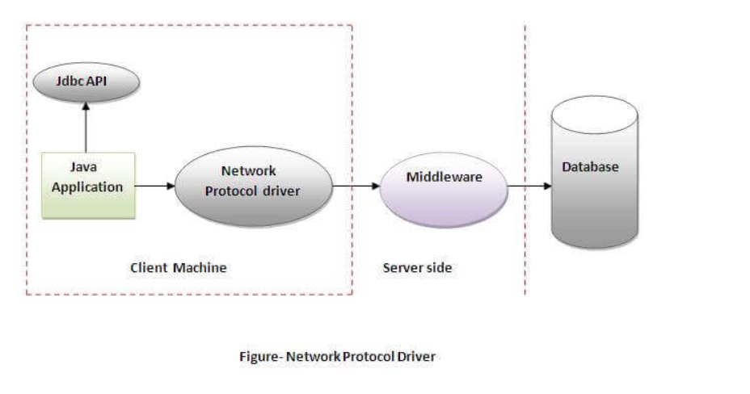

Slide 15
Advantage:
No client side library is required because of application server that can perform many tasks like auditing, load balancing, logging etc.
Disadvantages:
Network support is required on client machine.
Requires database-specific coding to be done in the middle tier.
Maintenance of Network Protocol driver becomes costly because it requires database-specific coding to be done in the middle tier.

Slide 16
Thin driver

Slide 17
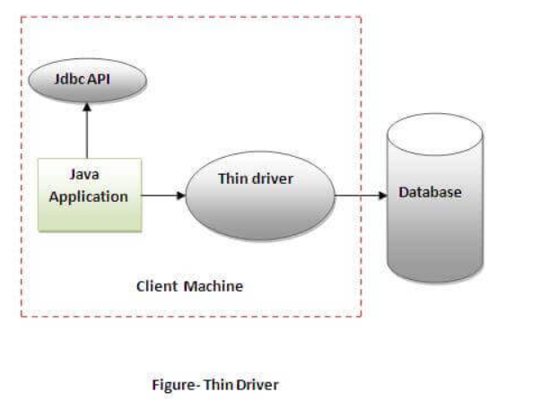

Slide 18
Advantage:
Better performance than all other drivers.
No software is required at client side or server side.
Disadvantage:
Drivers depend on the Database..

Slide 19
Java Database Connectivity with MySQL
Driver class: The driver class for the mysql database is com.mysql.jdbc.Driver.
Connection URL: The connection URL for the mysql database is jdbc:mysql://localhost:3306/sonoo where jdbc is the API, mysql is the database, localhost is the server name on which mysql is running, we may also use IP address, 3306 is the port number and sonoo is the database name. We may use any database, in such case, we need to replace the sonoo with our database name.
Username: The default username for the mysql database is root.
Password: It is the password given by the user at the time of installing the mysql database. In this example, we are going to use root as the password.

Slide 20
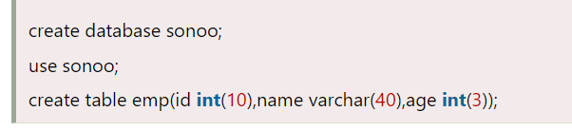

Slide 21
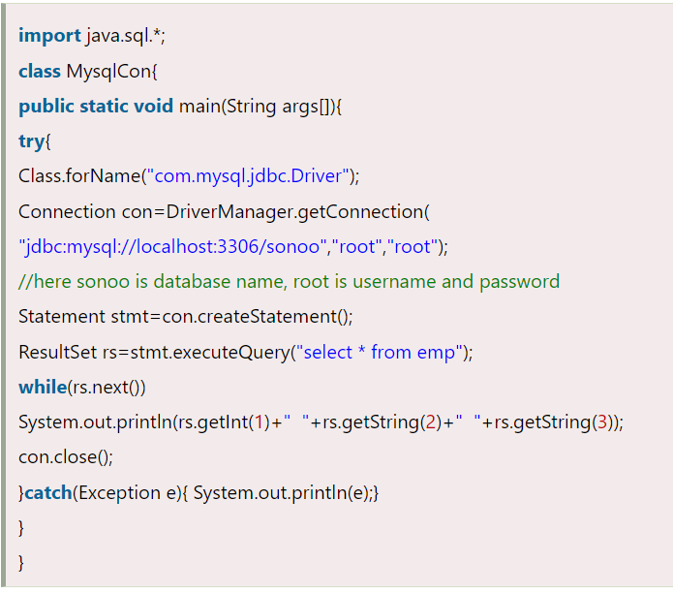

Slide 22
Example to inserts the record

Slide 23
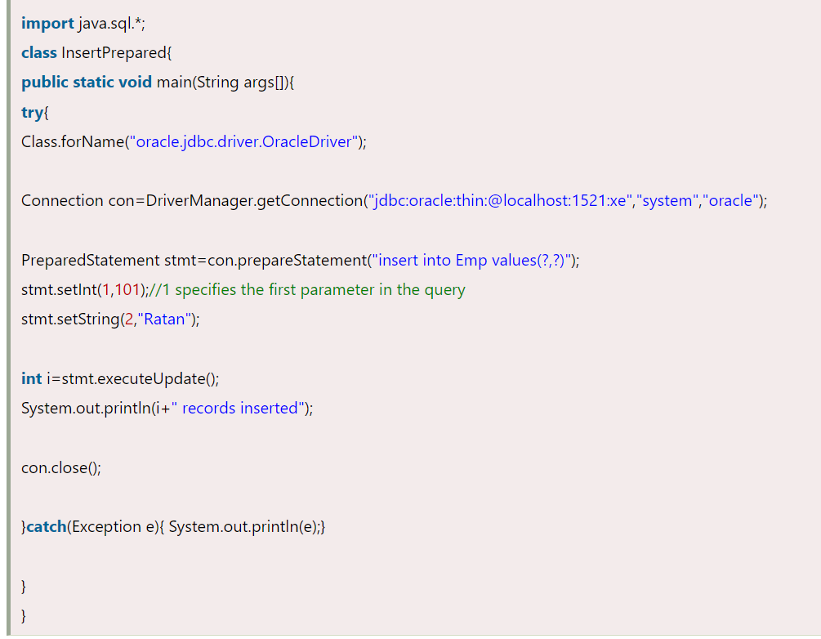

Slide 24
Example to updates the record

Slide 25
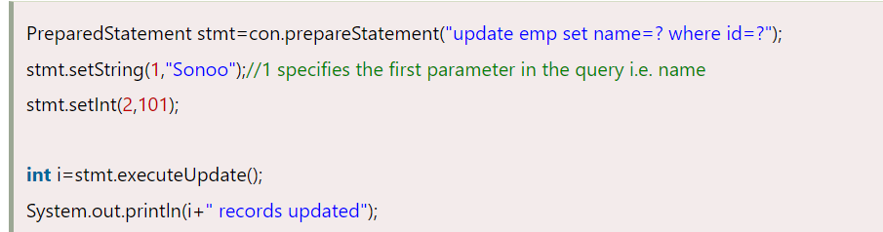

Slide 26
Example to deletes the record

Slide 27
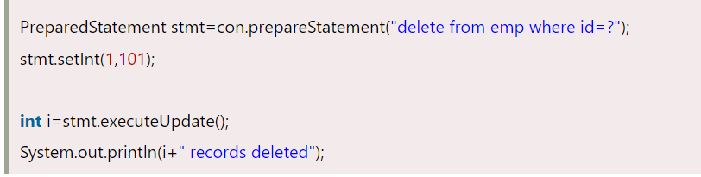

Slide 28
Example to retrieve the records of a table

Slide 29
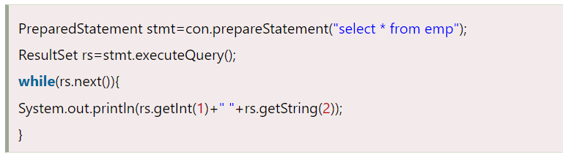

Slide 30
Statement interface
1) public ResultSet executeQuery(String sql): is used to execute SELECT query. It returns the object of ResultSet.
2) public int executeUpdate(String sql): is used to execute specified query, it may be create, drop, insert, update, delete etc.
3) public boolean execute(String sql): is used to execute queries that may return multiple results.
4) public int[] executeBatch(): is used to execute batch of commands.

Slide 31
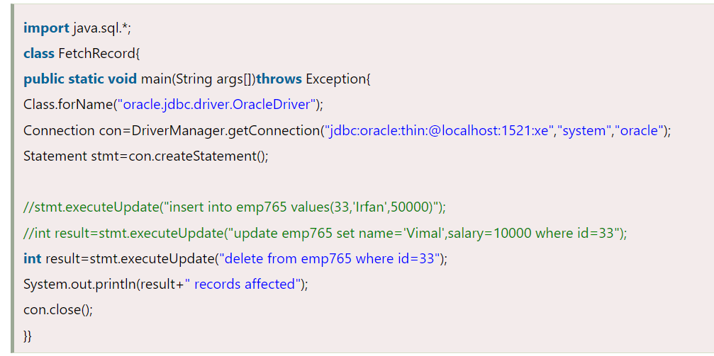
Example of Statement interface

Slide 32
PreparedStatement interface
The PreparedStatement interface is a subinterface of Statement. It is used to execute parameterized query.

Slide 33
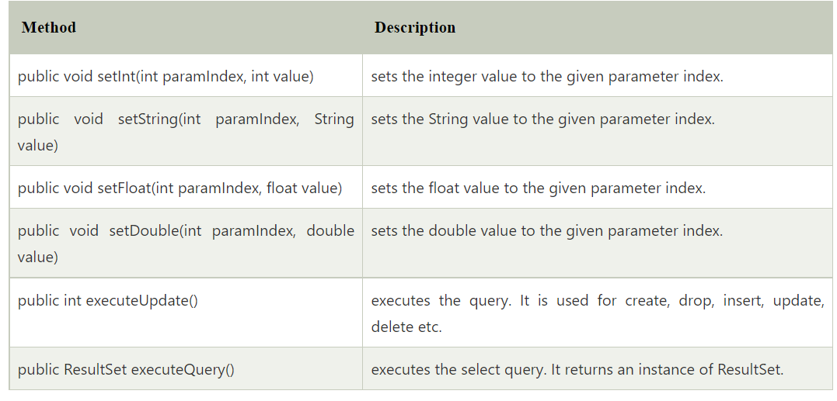
Methods of PreparedStatement interface

Slide 34
Java CallableStatement Interface
CallableStatement interface is used to call the stored procedures and functions.

Slide 35
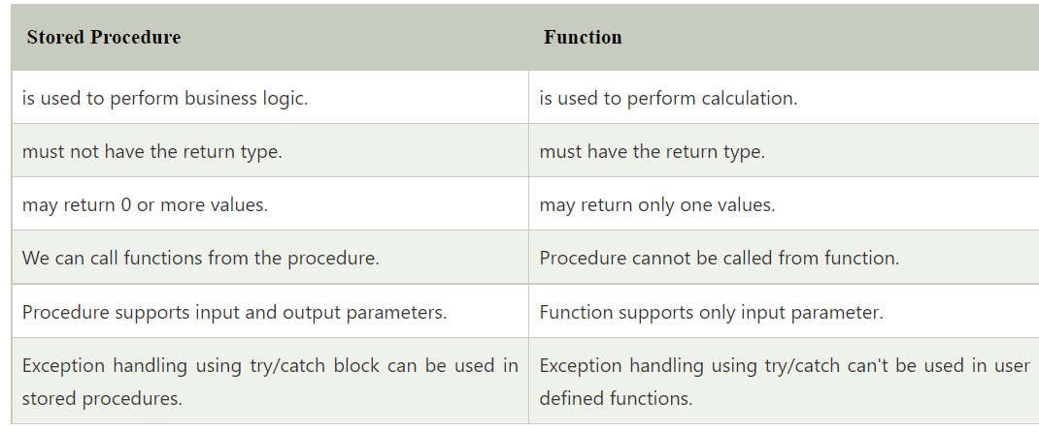
What is the difference between stored procedures and functions.

Slide 36
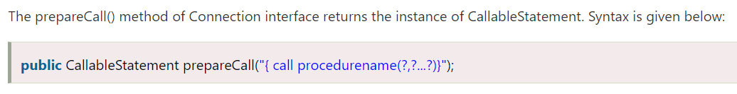
How to get the instance of CallableStatement?

Slide 37
Java Functional Interfaces
An Interface that contains exactly one abstract method is known as functional interface. It can have any number of default, static methods but can contain only one abstract method. It can also declare methods of object class.

Slide 38
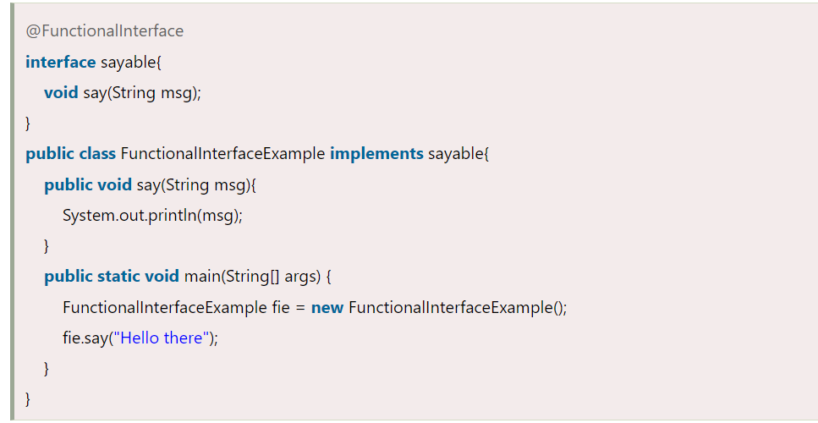

Slide 39
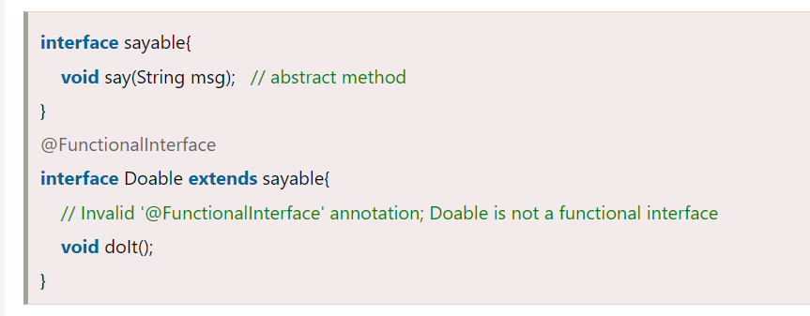
Invalid Functional Interface

Slide 40
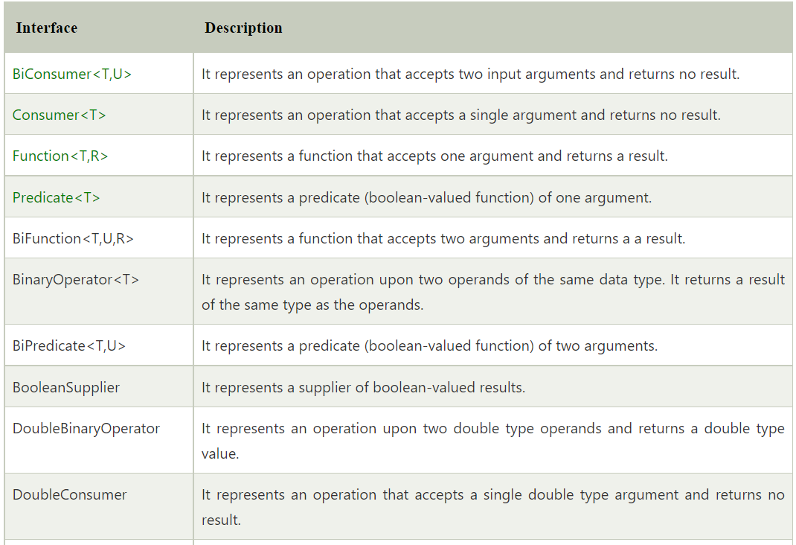
Java Predefined-Functional Interfaces

Slide 41
THANK YOU
NEEHARIKA

